Slide 1
Ponder accelerator 思考加速器

Slide 2
motivation
There are 200 billion brain cells in the human brain, which can store 100 billion messages. It can also produce 4000 thoughts every 24 hours. It is the most sophisticated and the most sensitive organ in the world. According to the study, humans use only 3%~4% of their brains in the lifetime. Therefore, we want to invent an instrument that can fully develop human potential
人腦中有2千億個腦細胞、可儲存1千億條訊息，平均每24小時產生4千種思想，是世界上最精密、最靈敏的器官。研究發現，人類終其一生大腦只運用了3％～4％，因此我們想發明一個可以將人類潛力完全發揮的器具

Slide 3
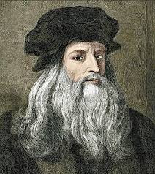
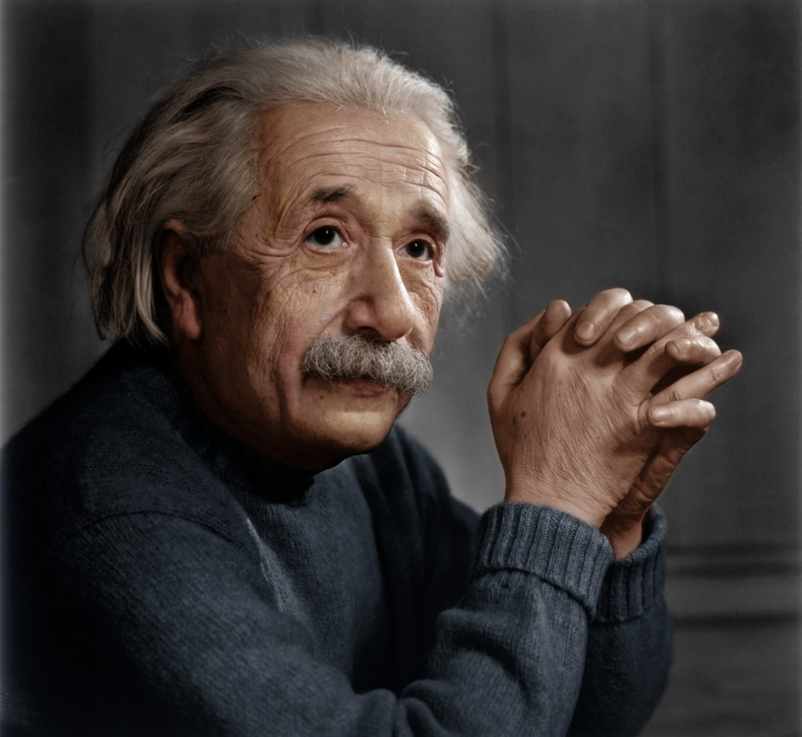
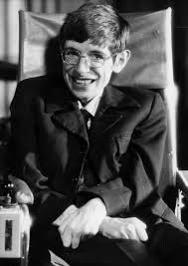
inspiration
Hawking, Einstein, Newton, Da Vinci, Ptolemy, etc., their brains are developed more than us. Actually, our brains are actually more unpredictable in our mind.
If the brain continues to develop, will it be like the movie Lucy plot? Can we abstract creations? Can we control other things? Can we become other things? Can we jump off the frame of time and space?
基於我們的大腦只使用到3~4%，我們很難想像人腦繼續開發會發生甚麼事情。或許像霍金，愛因斯坦，牛頓，達文西，托勒密等人，他們的大腦開發的比我們更多，我們的大腦，其實比我們認知中更深不可測.
那如果大腦繼續開發下去呢?會像電影<露西>一樣嗎?能憑空造物嗎? 能操情他物品嗎?能變成其他物品嗎?能跳脫時空的框架嗎?

Slide 4
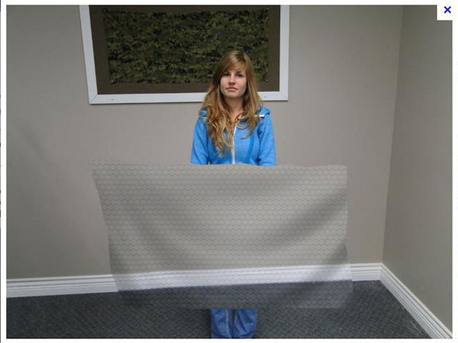
function
1. As the name implies, thinking accelerates.(顧名思義，思考加速) You can start using this product by saying “Burst Link”.
2. While you use it you wil feel exciting and won't feel tire.(當進行思考動作時可以得到精神亢奮的效果) Keep you doing the samething continuously.(讓你持續地做同件事情)
3.The archetype of the machine is like a helmet(造型就原本的安全帽) And we use the latest invisible material to hide high-tech items.(我們使用了最新隱形材質，將高科技物品全部隱藏) Achieve to protect our customers.(達到保障我們的客戶)

Slide 5
Reflection反思
Accelerating your own thinking , and making yourself achieve as soon as possible.(使自己在有限的時間內達到平時不可能的結果。) For the future, it may have lots of developments. e.g. developing into another world war (as stated in a novel), or developing into utopian world-- eradicating political corruption 、 War-torn(對於未來，它或許可能有其他的發展。如:發展成另一個世界戰爭(某部小說裡所說的)、或發展成烏托邦的世界，改變了社會的上政治腐敗、械鬥分生、病態滿窗的問題。)
Ponder accelerator seems like good things, but we can't insure its future possibilities, and relying on technology to gradually stop busy life can make our be mare happy ? Or we indulge in it? (思考加速器看似好東西，但是我們無法保證其未來的可能性，而且對依靠著科技而逐漸停止忙碌生活的我們，生活上真的會更有樂趣嗎?我們真的需要思考加速器嗎?)

